Slide 1
The UPC’s long arm jurisdiction
22 September 2026 | Tilman Pfrang, LL.M. | Munich

Slide 2
Agenda
Long-arm jurisdiction – the CoA’s referral to the CJEU
Long-arm jurisdiction and Art. 7 (2) Brussels I recast
Long-arm jurisdiction - the CoA’s first consolidation
BSH v. Electrolux translated into a UPC constellation
The UPC compared with national courts with respect to the long arm question
Scenarios

Slide 3
Long-arm jurisdiction – the CoA’s referral to the CJEU

Slide 4
CJEU referral: Dyson v. Dreame et al, UPC_CoA_789/2025 and
UPC_CoA_813/2025 (CoA 6 March 2026)
  Defendant constellation:
  Dreame: Non-EU manufacturer based in Hong Kong
  Eurep: Germany-based authorized representative for the EU territory (regulatory access); used as anchor defendant for Spain (i.e. a EU-but-non-UPC-State like Hungary)
  Other defendants: EU distributors / affiliates (sales structure); not relevant for the long arm (Spain)
  Sales in UPC states + Spain:
  → Key issue: Can the UPC use Eurep to establish jurisdiction over the Hong Kong manufacturer, including with respect to Spain?

Slide 5
CJEU referral: Question 1 – proposal for simplification
  Can the UPC hear a case against a non-EU defendant concerning infringement of the national part of a European patent in a non-UPC EU state (e.g. Spain) if there is also a defendant in a UPC state because otherwise there would be a risk of conflicting decisions – even if the UPC-territory-based defendant is not an infringer but merely an intermediary?

Slide 6
CJEU referral: Question 2 – proposal for simplification
  Can the UPC grant provisional measures against a non-EU defendant not only for the UPC territory but also for a non-UPC EU state, if the same allegedly infringing products are offered in both territories via essentially identical websites?

Slide 7
CJEU referral: Question 3 – proposal for simplification
  Does it matter for question 2 that the non-EU defendant uses a company located in a UPC state (for example an EU representative or distributor) to market the products in Europe?

Slide 8
CJEU referral: Question 4 – proposal for simplification
  Can the UPC grant an injunction against an EU-based authorised representative (for example a product-compliance representative) as an intermediary, even if that company does not itself infringe the patent but only enables market access of the non-EU manufacturer?

Slide 9
Long-arm jurisdiction and Art. 7 (2) Brussels I recast

Slide 10
Keeex v Adobe, OpenAI and others – Court of Appeal, 13 March 2026 (UPC_CoA_922/2025, UPC_CoA_923/2025, UPC_CoA_924/2025, UPC_CoA_925/2025)
  Headnotes:
  As a rule, the Statement of claim should contain the facts and legal arguments necessary to justify the jurisdiction of the Court.
  Where the UPC has jurisdiction on the basis of Article 7(2) of Regulation 1215/2012 as the court of the place where the damages occurred or threaten to occur, said article does not provide jurisdiction for infringement in non-member states of the UPC.

Slide 11
1st headnote: As a rule, the Statement of claim should contain the facts and legal arguments necessary to justify the jurisdiction of the Court.
  Court may examine its jurisdiction on the basis of all available information (CJEU case law).
  However: Rule 13.1(i) RoP requires an explanation of the Court's jurisdiction.
  And: Parties must present their case in full as early as possible.

Slide 12
2nd headnote: Where the UPC has jurisdiction on the basis of Article 7(2) of Regulation 1215/2012 as the court of the place where the damages occurred or threaten to occur, said article does not provide jurisdiction for infringement in non-member states of the UPC
  Article 7
  A person domiciled in a Member State may be sued in another Member State:
  (1)…
  (2) in matters relating to tort, delict or quasi-delict, in the courts for the place where the harmful event occurred or may occur;

Slide 13
2nd headnote
  Art. 7(2): territorial limitation
  Art. 33(1)(a) UPCA is interpreted consistently with Art. 7(2) Brussels I recast
  The Court relied on CJEU:
    Fiona Shevill
    Pez Hejduk
  A court acting as the court of the place where damage occurs has jurisdiction only for damage occurring in its own territory.
  No reliance on BSH v Electrolux for such scenario.

Slide 14
Art. 7(2) – Two possible connecting factors
Place of damage | Place of event giving rise to damage
Keeex (CoA 2026) | Hurom v. NUC (LD Mannheim 2025)
No long arm | Potential long arm jurisdiction
CJEU: Fiona Shevill / Pez Hejduk | CJEU: Wintersteiger
Damage occurs in forum state | Causal act occurs in forum state
  Open question after Keeex: Does the Court of Appeal reject only the place-of-damage route, or also the place-of-the-event-giving-rise-to-the-damage route?

Slide 15
Long-arm jurisdiction - the CoA’s first consolidation

Slide 16
Fujifilm v Kodak, Court of Appeal, 2 June 2026, UPC_CoA_312/2025, UPC_CoA_333/2025, UPC_CoA_880/2025, UPC_CoA_882/2025
The Court of Appeal confirms that the UPC may hear infringement actions concerning non-UPC designations of European patents where jurisdiction exists under Brussels Ia (Art. 4)
Not a new theory but a consolidation of first instance decisions and orders
Guidance on application of BSH v Electrolux in UPC practice

Slide 17
Art. 34 UPCA is not a jurisdictional limitation
Art. 34 UPCA merely defines territorial scope of decisions
Does not define international jurisdiction
The UPCA contains no indication that the Contracting Member States intended to confer a narrower jurisdiction on the UPC than national courts enjoy under Brussels I recast

Slide 18
BSH v Electrolux confirmed for the UPC
Defendant domiciled in UPC territory
Art. 4 Brussels I recast: UPC has jurisdiction
UPC cannot decline jurisdiction merely because a foreign court may be a more appropriate forum
  -> CoA relies on CJEU in Owusu (of 2005) and BSH v Electrolux
Consequence: UK part of a European patent may be litigated before the UPC where Brussels I recast jurisdiction exists

Slide 19
Validity challenges in foreign designations
The CoA provides a practical framework
If validity of the foreign patent designation is challenged, the UPC may:
  invite withdrawal of the foreign part of the action
  allow time for national revocation actions (very relevant for cases with Hungarian part of the EP patent enforced)
  stay proceedings
  decide infringement subject to the outcome of national validity proceedings

Slide 20
The CoA's consolidation of UPC long-arm case law
What is now relatively clear?
Art. 34 UPCA is not a jurisdictional restriction
Art. 4 Brussels I recast supports actions concerning non-UPC parts of the EP
Foreign validity disputes do not automatically deprive the UPC of jurisdiction
→ Bottom line: BSH v Electrolux fully applies before the UPC

Slide 21
The CoA's consolidation of UPC long-arm case law
What remains open?
Art. 7(2) Brussels I recast after Keeex if jurisdiction is based on Place of the event giving rise to the damage
Art. 8 Brussels I recast (co-defendants; Dyson referral)
Scope of Art. 71b(3) Brussels I recast

Slide 22
BSH v. Electrolux translated into a UPC constellation

Slide 23
Country groups (of EPC member states)
Group 1: EU states that have ratified the UPCA
Group 2:
      EU states with pending UPCA ratification
      EU states not participating in the UPCA
      States party to the Lugano Convention
Group 3: Remaining EPC (and non-EU) member states

Slide 24
Jurisdiction of the UPC in case of defendant's domicile in the UPC territory
 | Group 1 | Group 2 (e.g. Hungary) | Group 3 | Group 4 (non-EPC member states, e.g. US/JP)
International Jurisdiction for Infringement | Yes | Yes | Yes | No
International Jurisdiction for Revocation | Yes (with erga omnes effect) | No | Yes (with inter partes effect) | No

Slide 25




The UPC compared with national courts with respect to the long arm question

Slide 26
UPC vs. German courts in view of JP patents
The UPC is a court of limited attributed jurisdiction. It possesses only those powers conferred by the UPCA, i.e. its reach is limited to the EPC territory.
A German Landgericht (“district court”), on the other hand, is a court of general jurisdiction. Unless a statute withdraws jurisdiction, it may adjudicate any civil dispute properly brought before it.
→ German courts can – arguably – also decide on infringement and inter partes validity of Japanese patents!

Slide 27
UPC vs. UK courts in view of foreign (e.g. US) patents
English courts may, in principle, hear infringement claims concerning foreign patents where they have personal jurisdiction over the defendant; foreign patent law is applied as the applicable substantive law (Lucasfilm; Chugai).
However, English courts will not directly determine the validity of a foreign patent. Under the Moçambique principle, challenges to the validity of a U.S. patent remain for the U.S. courts (GW Pharma).
Unlike the Brussels Ia regime, English courts retain a broad forum non conveniens discretion, allowing them to decline jurisdiction where the courts of the protecting state (e.g. the U.S.) are the more appropriate forum.

Slide 28

UPC vs. Hungarian courts in view of foreign (e.g. US) patents
A short word of caution: on Hungarian law, you are the experts and I am not.
The questions I would put to you, rather than answer:
  Would a Hungarian court hear an infringement claim concerning a foreign (e.g. US) patent where it has jurisdiction over the defendant under Art. 4 Brussels Ia?
  If so, would it decide validity raised as a defence inter partes, or leave that to the courts of the protecting state?
  Does Hungarian procedure offer anything comparable to a stay pending foreign validity proceedings?

Slide 29
Scenarios

Slide 30
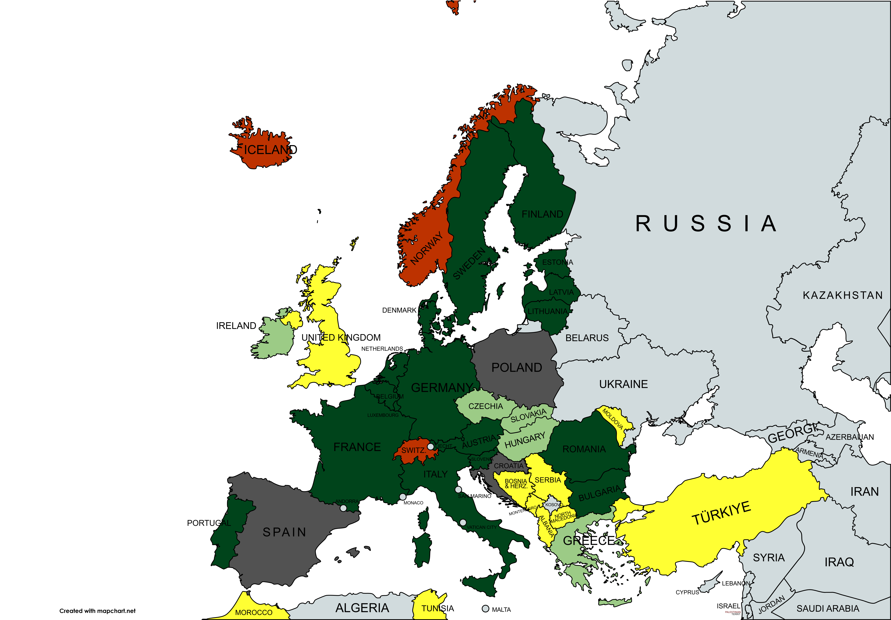
Long-arm jurisdiction
Country groups
EU states that have ratified the UPCA
EU states with pending UPCA ratification
EU states not participating in the UPCA
States party to the Lugano Convention
Remaining EPC member states, validation states and extension states
(Not shown: Cambodia, Laos)

Slide 31
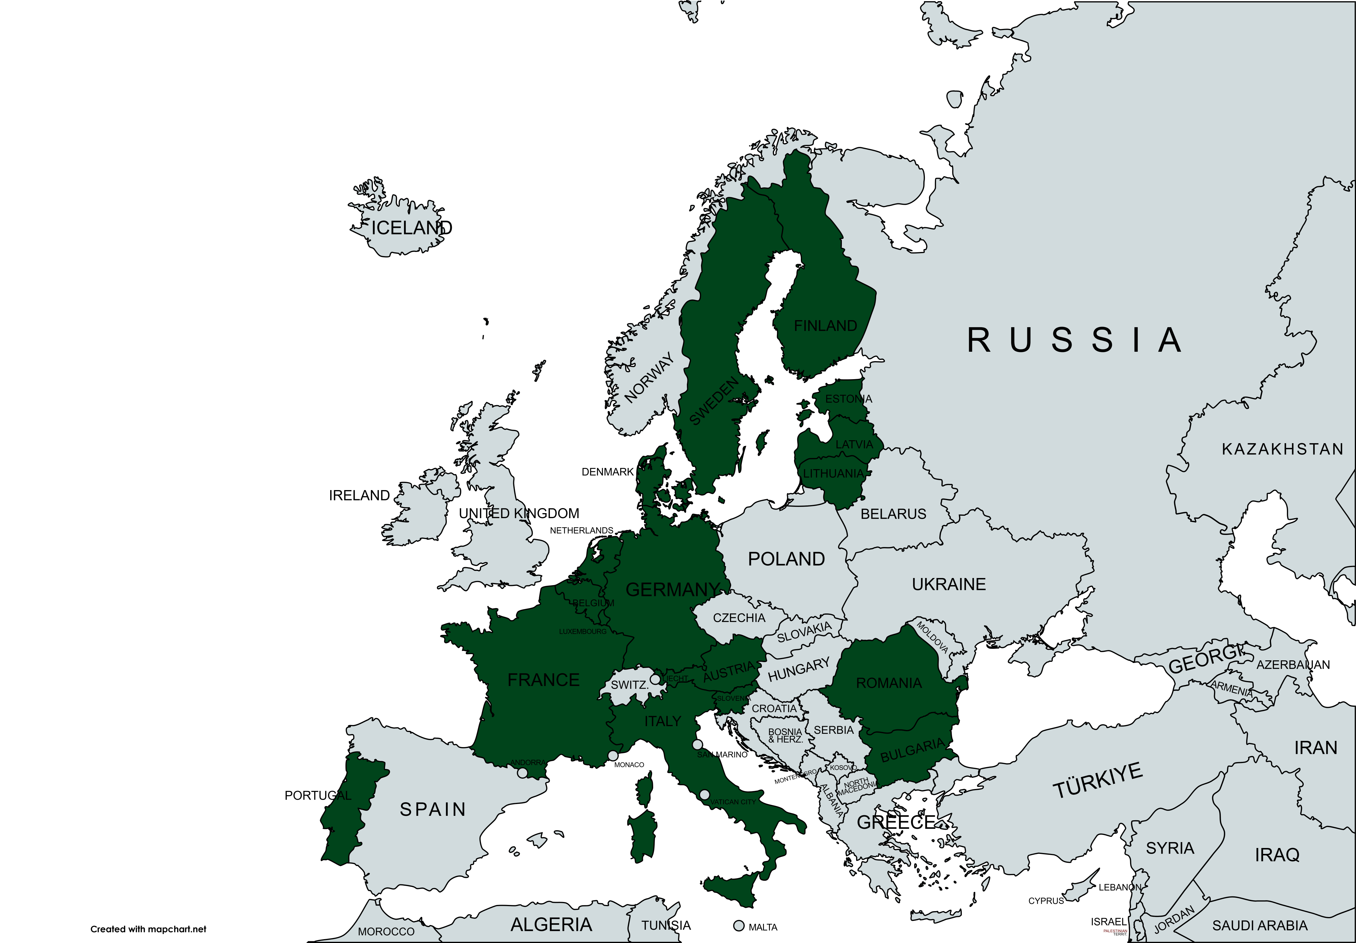
Long Arm Jurisdiction of the UPC
Case 1 (normal case)
Infringement action before the UPC based on a unitary patent:
Invalidity defence admissible, but only if a revocation action or counterclaim for revocation has been brought before the UPC (Rule 25(1) RoP);
then, if applicable, revocation also with third-party effect

Slide 32
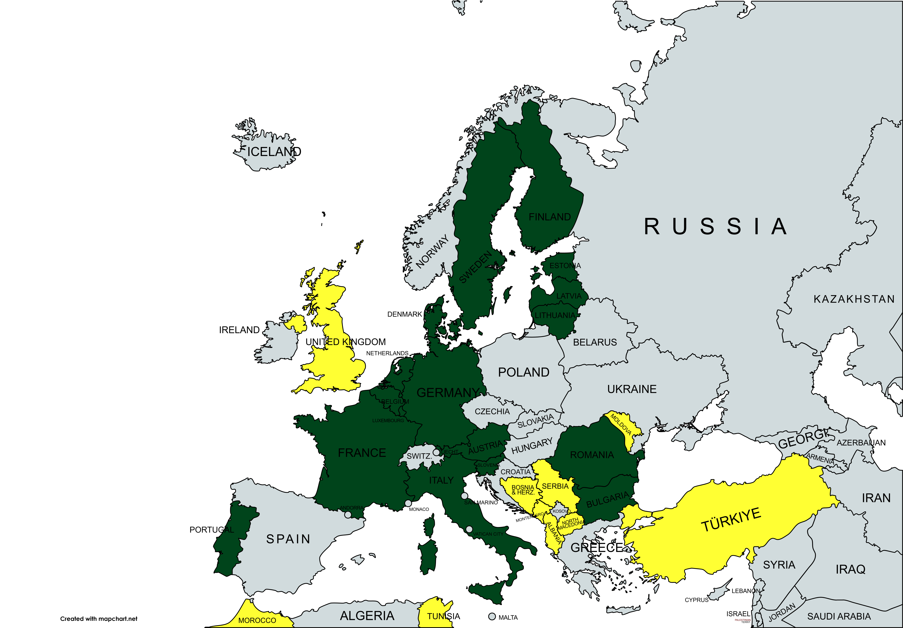
Long Arm Jurisdiction of the UPC
Case 2
Infringement action under the UPC based on a unitary patent, including parts of the remaining (bundle) patent that are not located in EU Member States (third countries).
Art. 24 No. 4 Brussels Ia Regulation does not apply to these parts
Decision-making authority both on the question of infringement and on the plea of invalidity
However: invalidity defence for unitary patents only in the case of revocation (counter)claims (R. 25(1) RoP), for national parts of the EP only inter partes and not with third-party effect.

Slide 33
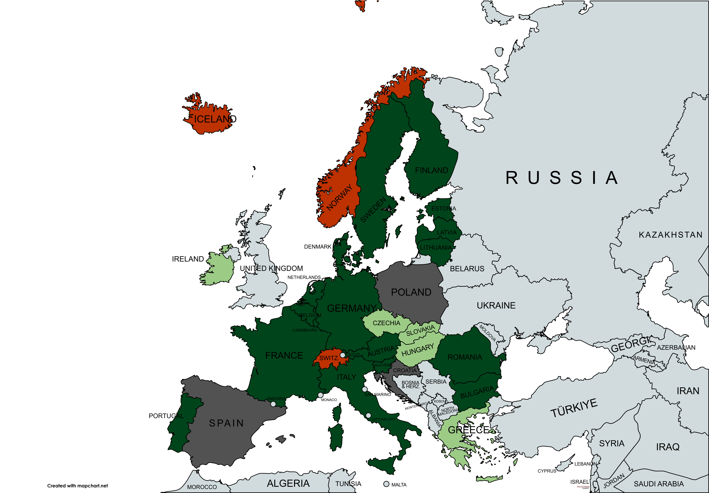
Long Arm Jurisdiction of the UPC - Case 3
Infringement action based on the unitary patent and parallel parts of the (remaining) European (bundle) patent in EU countries where
  due to non-participation in the UPCA (Croatia, Poland, Spain)
  or due to pending ratification of the UPCA (Hungary, Czechia, Slovakia, Greece, Cyprus, Ireland)
  no unitary effect has occurred, but the parts are nationally validated there
also in states of the Lugano Convention (Iceland, Norway, Switzerland): Art. 22 No. 4 Lugano Convention applies to these parts
→ UPC has decision-making authority only on the question of infringement.
→ Legal status of the parts must be accepted; no decision on plea of invalidity.
At most, limited suspension in the event of national validity proceedings.
→ Action for revocation or counterclaim for revocation against the unitary patent before the UPC possible and necessary (R. 25(1) RoP)

Slide 34
Long Arm Jurisdiction of the UPC - Case 4
Infringement action before the UPC based on a European (bundled) patent exclusively with EP parts in EU Member States that participate in the UPCA and have ratified it
Invalidity defence admissible, but only if a revocation action or counterclaim for revocation has been brought before the UPC (Rule 25(1) RoP);
then, if applicable, revocation also with third-party effect.
In the case of a purely national action for revocation against parts of the European (bundled) patent during the transitional phase, stay of the UPC infringement proceedings for the contested part is possible under Art. 71c (2), 30 Regulation (EU) 1215/2012 or R. 295(m) RoP.

Slide 35
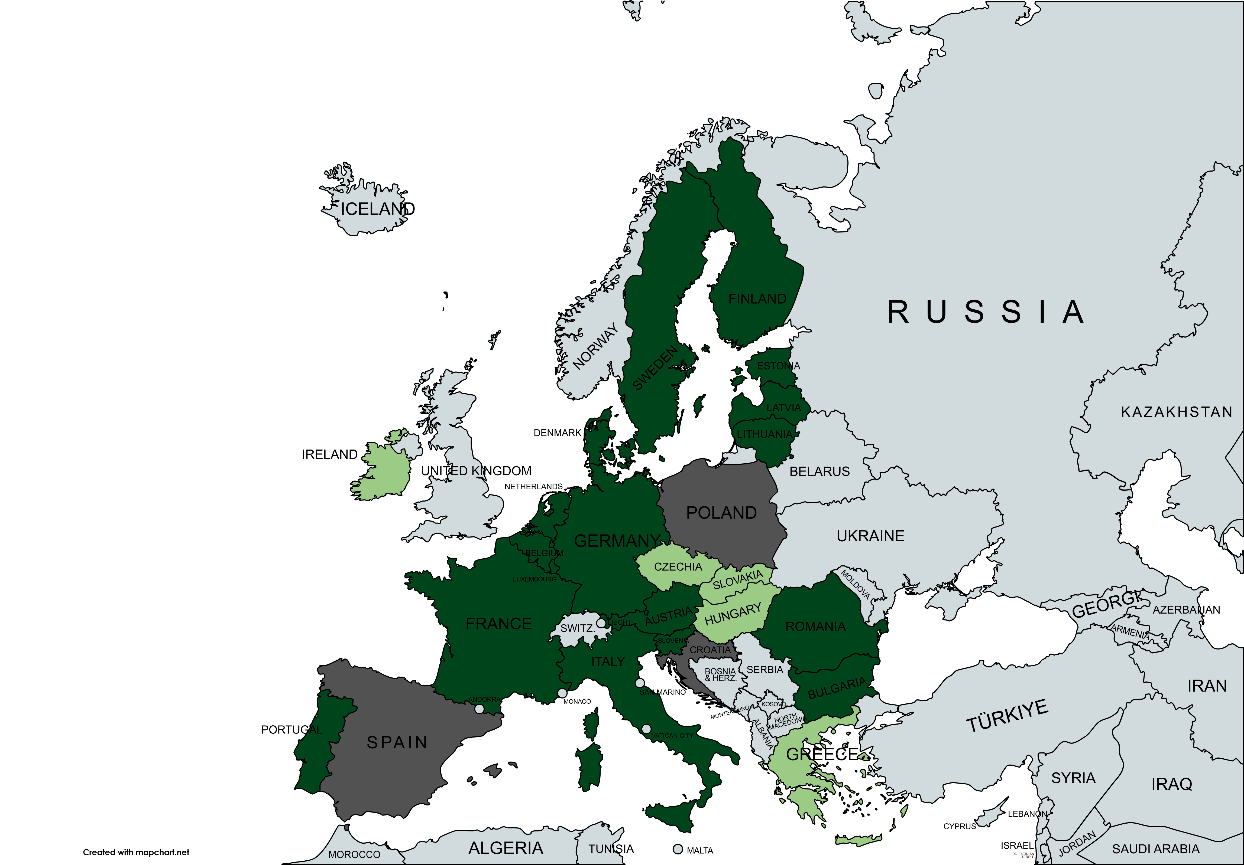
Long Arm Jurisdiction of the UPC
Case 5
Infringement action based on a European (bundled) patent including parts in EU Member States that are not parties to the UPCA or have not (yet) ratified it:
For these parts, the UPC only has decision-making authority on the question of infringement.
The legal status of the foreign parts must be accepted; at most, suspension in the event of national validity proceedings.
Revocation (counter)action before the UPC not possible.

Slide 36
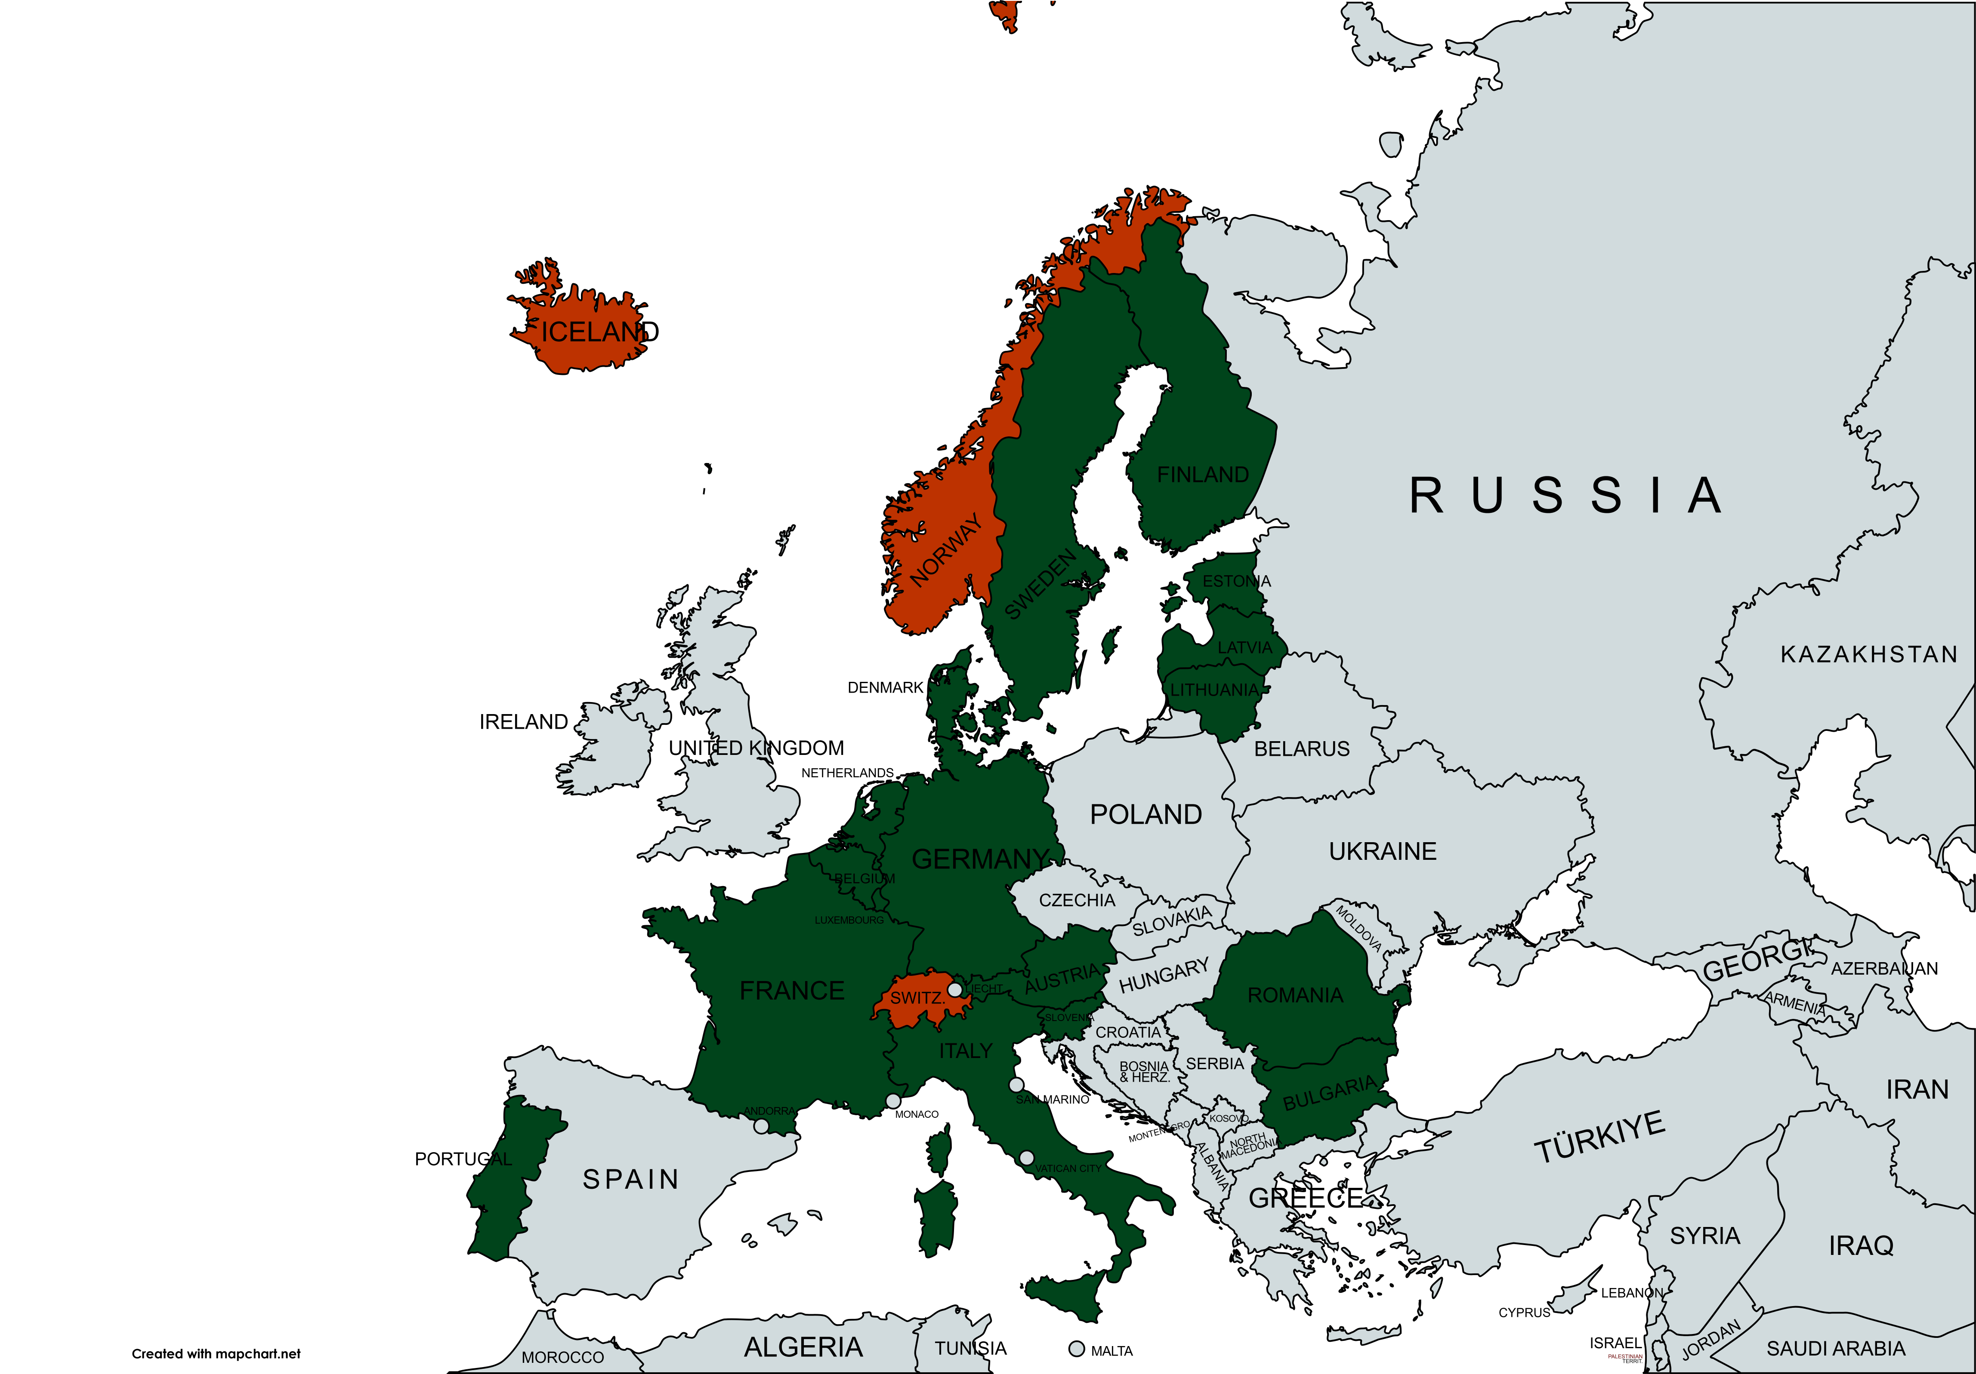
Long Arm Jurisdiction of the UPC
Case 6
Infringement action based on a European (bundled) patent including parts in third countries that are parties to the Lugano Convention:
For these parts, the UPC has decision-making authority only on the question of infringement.
The legal status of the parts in the states of the Lugano Convention must be accepted; at most, suspension in the event of national validity proceedings.

Slide 37
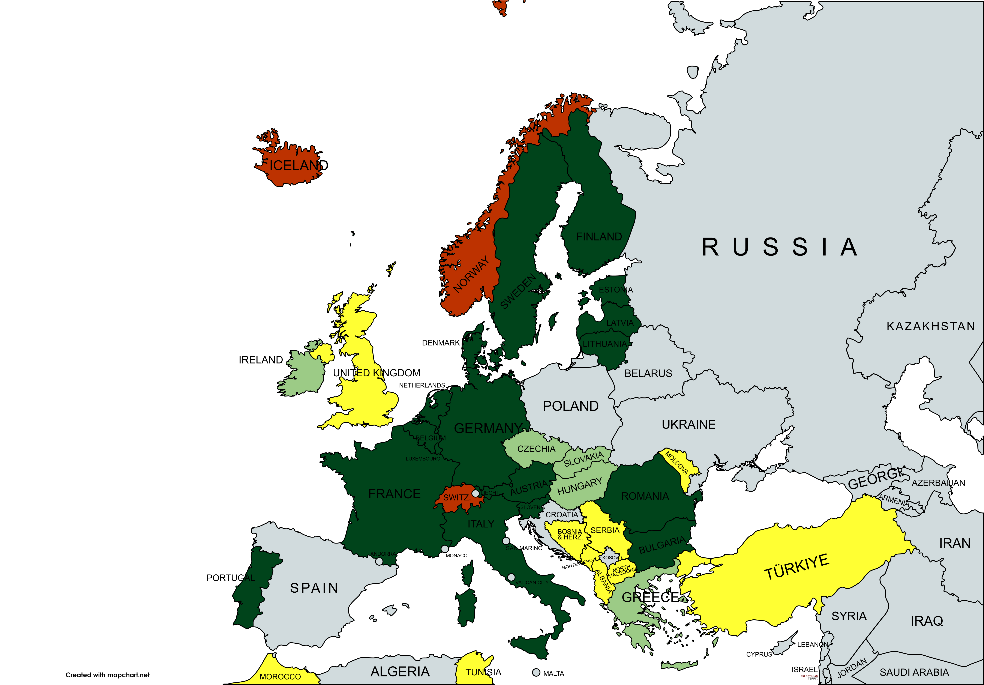
Long Arm Jurisdiction of the UPC
Case 7
Infringement action based on a European (bundled) patent including parts that are not located in EU Member States:
Decision-making authority with regard to these parts both in the infringement issue and on the invalidity defence
However, the invalidity defence is only inter partes and does not have third-party effect.

Slide 38
Standorte
Deutschland
UK
Stadt
Straße XX
XXXX Stadt
T +49 0000000
E mail@stadt.mb.de
Stadt
Straße XX
XXXX Stadt
T +49 0000000
E mail@stadt.mb.de
Stadt
Straße XX
XXXX Stadt
T +49 0000000
E mail@stadt.mb.de
Stadt
Straße XX
XXXX Stadt
T +49 0000000
E mail@stadt.mb.de
Stadt
Straße XX
XXXX Stadt
T +49 0000000
E mail@stadt.mb.de
Stadt
Straße XX
XXXX Stadt
T +49 0000000
E mail@stadt.mb.de
Stadt
Straße XX
XXXX Stadt
T +49 0000000
E mail@stadt.mb.de
Stadt
Straße XX
XXXX Stadt
T +49 0000000
E mail@stadt.mb.de
Stadt
Straße XX
XXXX Stadt
T +49 0000000
E mail@stadt.mb.de
Stadt
Straße XX
XXXX Stadt
T +49 0000000
E mail@stadt.mb.de
Stadt
Straße XX
XXXX Stadt
T +49 0000000
E mail@stadt.mb.de
Stadt
Straße XX
XXXX Stadt
T +49 0000000
E mail@stadt.mb.de
Stadt
Straße XX
XXXX Stadt
T +49 0000000
E mail@stadt.mb.de

