Slide 1

UPC – A CASE STUDY
How to get a European Patent revoked
Tilman Pfrang, LL.M., September 17 2024, Hungarian Chamber of Patent Attorneys

Slide 2
CASE STUDY
1
Legal background
2
Case specifics
3
Findings of the UPC
4
Reaction of the EPO
5
Lessons learned

Slide 3
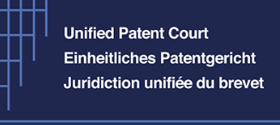





REVOCATION OF A EUROPEAN PATENT – HOW TO DO IT
What can be done
Standalone Revocation action
Counterclaim for revocation
National revocation action
Opposition (within 9 months deadline after grant)
What can be done in parallel
Several UPC revocation actions (by different parties)
UPC revocation action and national revocation action/s (also by the same party; UPC action cannot cover the attacked part of the national revocation action/s)
UPC revocation action and EPO opposition (also by the same party)
Notes:
Actions to support LitCom meetings:
Assist subcommittees in preparation of agenda items
Support subcommittees to ensure that agreed action items are carried out
Keep records of activities

Slide 4
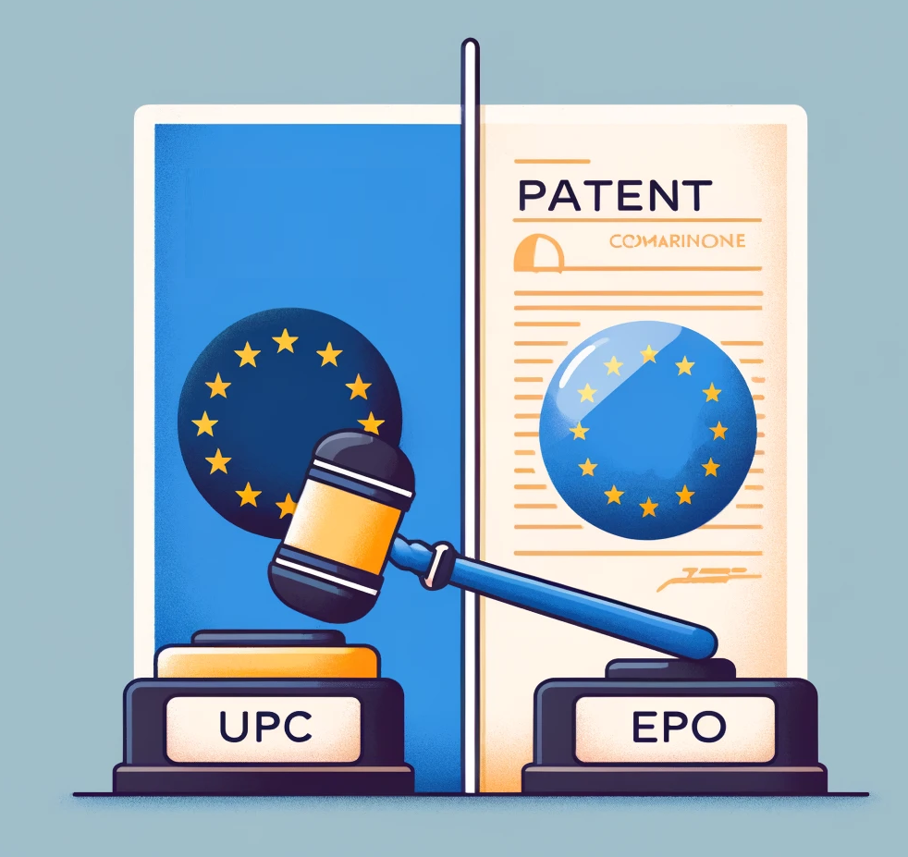
UPC REVOCATION ACTION VS. EPO OPPOSITION
Run in parallel
Opposition covers broader territory
UPC may stay proceedings if EPO decision to be expected in short (“rapidly”)
EPO “promises” to accelerate opposition case if informed about the UPC case (no stay of proceedings at the EPO)
First decisions
  Munich case
  Paris cases
  Court of Appeal case
Notes:
Actions to support LitCom meetings:
Assist subcommittees in preparation of agenda items
Support subcommittees to ensure that agreed action items are carried out
Keep records of activities

Slide 5
UPC REVOCATION ACTION VS. EPO OPPOSITION
Place of Jurisdiction for UPC Revocation Actions
As a rule: Central Division (Art. 33 Para 4 Sentence 1 UPCA)
Exceptions: (1) Local or Regional Division, if an infringement action between the same parties relating to the same patent has been brought before said Local or a Regional Division (Art. 33 Para 4 Sentence 2 UPCA).
(2) If the revocation action is brought as a counterclaim in infringement proceedings, this has to be done before the Local or Regional Division dealing with the infringement proceedings. In this case, allocation of a technically qualified judge is possible (Art. 33 Para 3 lit a UPCA).

Slide 6
UPC REVOCATION ACTION VS. EPO OPPOSITION
Place of Jurisdiction for EPO Oppositions
As a rule: Munich
Exceptions: The Hague

Slide 7
UPC REVOCATION ACTION VS. EPO OPPOSITION
Addressee of a UPC Revocation Action
The action for revocation has to be directed “against the proprietor of the patent” (Rule 42.1 RoP).
Remark: A counterclaim for revocation is therefore not possible in an infringement action brought by a licensee (Art. 47.5 UPCA).
“Addressee” of an EPO Opposition
The Opposition has to be directed “against” the patent (Art. 99 Para 1 and Rule 76 Para 2 Lit. b EPC, “European patent against which opposition is filed”), but the proprietor has to be identified (Rule 76 Para 2 Lit. b EPC).

Slide 8
UPC REVOCATION ACTION VS. EPO OPPOSITION
Territorial Scope
UPC Revocation:
While decisions of the UPC on UPs cover the territory of all currently 17 EU Member States participating in the UPCA (“Contracting Member States”), decisions on classical, not opted-out EPs only cover the territory of the Contracting Member States of the UPCA for which said classical EP has effect, thus currently 18 at max. (Art. 34 UPCA). ➔ e.g. not: CH, UK
EPO Opposition:
Currently 39 EPC Member States + 1 Extension State (BA) + 5 Validation States (MA, MD, TN, KH, GE)
Notes:
BA = Bosnia and Herzegovina; MA = Morocco; MD = Republic of Moldova; TN = Tunisia; KH = Cambodia; GE = Georgia

Slide 9
UPC REVOCATION ACTION VS. EPO OPPOSITION
Duration of the Proceedings
EPO
After 15 months from filing of the notice of opposition, summons to oral proceedings are issued to take place in 6 months; ➔ approx. 2 years.
UPC
Oral proceedings take place after 9 months from the date on which the complaint has been served to the Defendant; ➔ approx. 1 year.

Slide 10
CASE STUDY – TIMELINE OF THE MAIN PROCEEDINGS
January 2024, summons with preliminary opinion
June 2023, filing the opposition
October 2024, oral proceedings
April 2024, interim hearing
June 2023, filing the revocation action
July 2024, decision
March 2024, summons
June 2024, final hearing

Slide 11
CASE STUDY – TIMELINE OF THE REQUEST FOR STAY PROCEEDINGS
15 December 2023, response to request
1 December 2023, filing the request for stay
8 January 2024, final decision (order)
23 January 2024, filing the appeal
5 May 2024, oral hearing
12 March 2024, summons
28 May 2024, final decision (order)

Slide 12
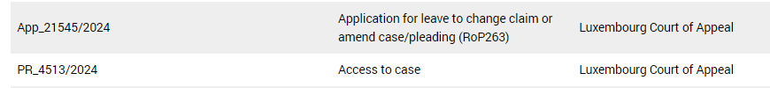
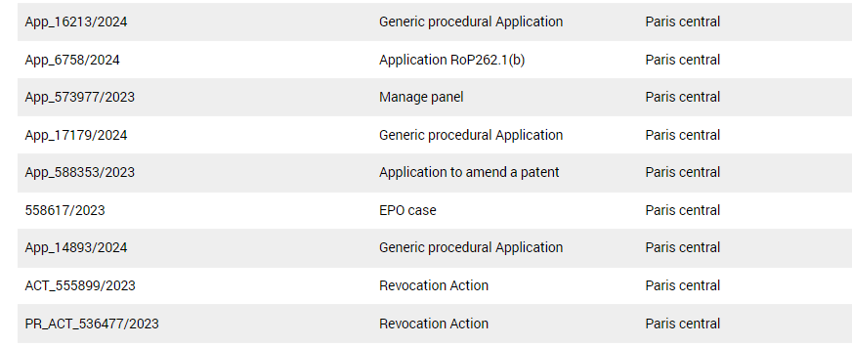
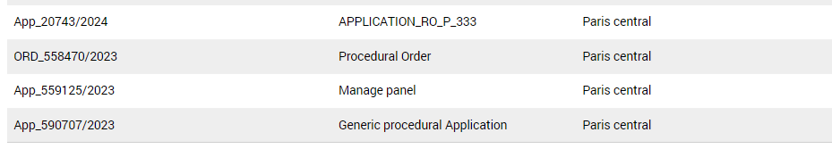
CASE STUDY - CMS

Slide 13
STAY OF PROCEEDINGS – CASE LAW
First decisions
Munich case: UPC_CFI_80/2023 → no stay
Paris case I: UPC_CFI_263/2023 → no stay, confirmed by CoA
Paris case II: UPC_CFI_361/2023 → no stay
Notes:
Discuss the Library and the Forum

Slide 14
STAY OF PROCEEDINGS – MUNICH CASE: UPC_CFI_80/2023
Court's Considerations
EPO's Decision Timeline: First instance decision expected in just over three months; court doubts if this is "rapid“.
Balancing of Interests: Interests of the revocation claimant in pursuing the case generally outweighs the defendants' interests in waiting for EPO's decision.
Appeal Likelihood: likelihood of appeal may be of relevance for the decision to stay proceedings.
Result
No stay
Leave to appeal granted (no appeal known)
Notes:
Discuss the Library and the Forum

Slide 15
STAY OF PROCEEDINGS – PARIS CASE I: UPC_CFI_263/2023
Court's Considerations
EPO's Decision Timeline: No concrete proof for a date for oral proceedings/EPO decision.
Balancing of Interests: Examination of interest of avoiding parallel proceedings against the claimant’s right to access justice.
Territorial and Substantive Scope: The broader territorial and substantive scope of the EPO opposition compared to the UPC action is irrelevant to the decision.
Consideration of Proceedings Stage: The timing of the EPO's decision relative to the Unified Patent Court proceedings is a key factor. A stay is less appropriate when the UPC proceedings are well advanced. In general, stay of proceedings only if EPO proceedings “near to the end and the proceedings before the Unified Patent Court has just begun”?
Result
No stay
Leave to appeal granted
Notes:
Discuss the Library and the Forum

Slide 16
STAY OF PROCEEDINGS – APPEAL PROCEEDINGS BASED ON PARIS CASE I: UPC_COA_22/2024
Court's Considerations
UPC proceedings should generally progress to the final hearing within one year unless the specifics of the case demand otherwise.
While acknowledging the potential for differing decisions from the UPC and EPO, the Court noted that such outcomes do not inherently conflict, as the latter would prevail.
In line with Articles 41(3), 42, and 52(1) of the UPCA, the UPC Division dealing with the case retains discretionary power to stay proceedings. This power is to be exercised cautiously, with a “rapid” decision from the EPO being a prerequisite. The general acceleration of EPO proceedings does not meet this criterion.
Result
No stay
Notes:
Discuss the Library and the Forum

Slide 17
STAY OF PROCEEDINGS – PARIS CASE II: UPC_CFI_361/2023
Court's Considerations (in addition to Paris case I)
Parallel appeal case based on preliminary objection not relevant
Lifetime of the patent: Plaintiff has a legitimate interest to continue and possibly terminate the lawsuit before the patent expires. .
Danger of differing results not relevant.
Result
No stay
Notes:
Discuss the Library and the Forum

Slide 18
ACCELERATION OF EPO OPPOSITION PROCEEDINGS
EPO’s communication of 22 February 2024 “Acceleration of opposition proceedings in cases of parallel court actions​”
Source: https://www.epo.org/en/news-events/news/acceleration-opposition-proceedings-cases-parallel-court-actions, dated 22 February 2024
Requirements
  Upon “information” about parallel proceedings
  “Parallel” proceedings: infringement or revocation proceedings before the Unified Patent Court or a national court or competent authority of a contracting state
Notes:
Discuss the Library and the Forum

Slide 19
ACCELERATION OF EPO OPPOSITION PROCEEDINGS
Consequences
During the opposition period (i.e. in the nine months after grant of the European patent)
After expiry of the period, the proprietor will be invited to comment on the opposition within three months (instead of the usual four months) and summons will be issued within two months of receipt of the proprietor's reply, summoning the parties at minimum notice (Rule 115(1) EPC).
After expiry of the opposition period but before the proprietor's reply to the opposition
Summons to oral proceedings will be issued within two months of receipt of the proprietor's reply. The parties will be summoned at minimum notice (Rule 115(1) EPC).
After the proprietor has replied but before summons has been issued
Summons to oral proceedings will be issued within two months [before: “at the earliest possible date”] of receipt of the information on parallel proceedings. The parties will be summoned at minimum notice (Rule 115(1) EPC).
After summons has been sent
Oral proceedings are rescheduled to the earliest possible date (provided that the time saving is significant).
After the decision has been pronounced
The decision and the minutes will be issued within one month.
Notes:
Discuss the Library and the Forum

Slide 20
ACCELERATION OF BOARD OF APPEAL PROCEEDINGS
BoA’s communication of 19 January 2024 “Notice from the Boards of Appeal on accelerating proceedings”
Party’s request under Article 10(3) RPBA, or
Request of the UPC under Article 10(4) RPBA
→ BoA will do their best
Notes:
Discuss the Library and the Forum

Slide 21
HOW DID THIS WORK OUT IN THE PRESENT CASE?
Central Division: No stay
Court of Appeal: No stay
Opposition Division: Summons for oral proceedings after 16 months from the opposition deadline – however some attempt was made in March 2024 to prepone it to April 2024 !!!
Notes:
Discuss the Library and the Forum

Slide 22
INTERIM HEARING IN THIS CASE
ViCo
Procedural Orientation/Formalities
Short (in this case 1 hour)
Judge rapporteur can decide on crucial issues such as admittance/non-admittance of late filed documents or requests or even “lines of attack”
Allowance of further written submissions are discussed (in this case not allowed, in other cases allowed)

Slide 23
MAIN HEARING IN THIS CASE (PARIS STYLE)
In person
Very short introduction of the presiding judge
Almost no question from the court
General invitation: The parties may now plead.
Pleadings: 1 h 15 min each party (no limits indicated by court)
Short responses possible: 5 to 10 min

Slide 24
FUTURE SCENARIOS
Current state: patent upheld in limited form by the UPC
  What does that mean for the pending EPO proceedings?
  What does this mean if EPO upholds another version of the patent?
Potential outcome: EPO and UPC decision are different (for the same contracting member states)
  Scenario 1: EPO version broader than UPC version (or vice versa)
  Scenario 2: EPO version and UPC version overlap (e.g. EPO version contains a “screw” and UPC version contains a “metallic fastening means”)
  Scenario 3: EPO version and UPC version are strict alternatives (e.g. EPO version contains a “screw” and UPC version contains a “nail”)

Slide 25
SCENARIO 1 - EPO VERSION BROADER THAN UPC VERSION (OR VICE VERSA)
Example
EPO claim: Fastening means.
UPC claim: Screw
→ Resulting scope of protection: Screw

Slide 26
SCENARIO 2 - EPO VERSION AND UPC VERSION OVERLAP
Example
EPO claim: Metallic Fastening means.
UPC claim: Screw.
  → Resulting scope of protection: Metallic screw.

Slide 27
SCENARIO 3 - EPO VERSION AND UPC VERSION ARE STRICT ALTERNATIVES
Example
EPO claim: Nail.
UPC claim: Screw.
  → Resulting scope of protection: Zero.

Slide 28
LESSONS LEARNED
Parallel UPC action is a powerful – but expensive – tool for accelerating EPO opposition proceedings → decision within 7 months from the end of the 9-months-period
Stay of proceedings possible but rather high hurdles
EPO must be “informed”
Notes:
Discuss the Library and the Forum

Slide 29
THANK YOU
for your attention!

